Slide 1
Unit 4 – Memory Management

Slide 2
Introduction
Program must be brought (from disk) into memory and placed within a process for it to be run
Main memory and registers are only storage CPU can access directly
Memory unit only sees a stream of addresses + read requests, or address + data and write requests
A functionality of OS which manages memory

Slide 3
Introduction (contd.)
The entire program and data of a process must be in main memory for the process to execute
It keeps track of the each and every memory allocation either it is allocated to some process or not
It decides which process gets the memory at what time
The part of OS which manages the memory is called memory manager

Slide 4
Memory Manager
It’s job is to:
keep track of which parts of memory are in use
allocate memory to processes
deallocate memory when processes are done
manage swapping between main memory and disk

Slide 5
Mono vs Multi Programming
Mono-Programming | Multi-Programming
Only one program at any point of time | Contains more than one program at a time
CPU executes the program but when I/O operation is encountered, CPU sits ideal. So, CPU isn’t efficiently used | CPU executes the program but when one program encounters I/O operation, CPU switches to next program. So, CPU is efficiently used
Memory needs less space | Memory needs more space
Fixed size partition is used | Both fixed and variable sized are used
Example: Old mobile OS | Example: Windows 7/8/10/11

Slide 6
Multiprogramming with fixed partition
Multiple processes run at the same time
Memory partitioned into fixed no. of partitions
In multiple input queues:
Large partition could be empty while the queue for a small partition is full
In separate input queues:
Since it is undesirable to waste a large partition on a small job
pick the largest job that fits
discrimination against small jobs
usually it is desirable to give the smallest jobs (often interactive jobs) the best service, not the worst

Slide 7
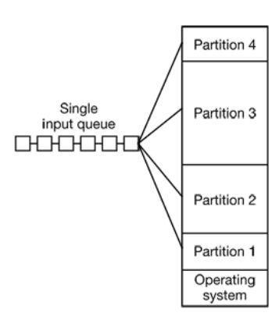
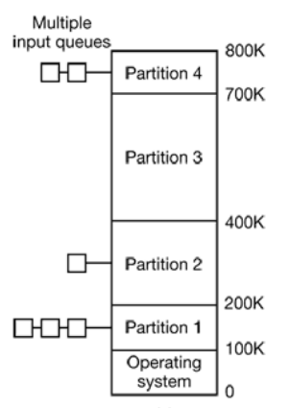
Multiprogramming with fixed partition (contd.)

Slide 8
Multiprogramming with dynamic partition
Multiple processes run at the same time
Memory partitioned dynamically
Meets the requirement of each requesting process – variable partitioning
When a process terminates or swapped, memory manager free up the space
Free Space for RAM
P1 = 30MB
P2 = 3MB
Operating System

Slide 9
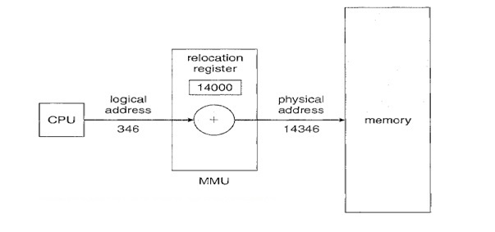
Relocation
the ability to load and execute a given program into memory
the program may be loaded at different memory locations, which are called physical addresses
Relocation is way to map logical addresses into physical addresses

Slide 10
Types of Relocation – Static and Dynamic
Static
Program must be relocated before or during loading of process into memory
Program must be loaded into same memory address space in memory
Dynamic
Process can be freely moved around the memory
Logical-to-Physical address mapping can be done at run time

Slide 11
Protection
A way to control memory access rights on a computer – memory protection
Main purpose is to prevent the process or program from accessing the memory that has not been allocated to it
Prevents malware or bugs present in the process to affect other process in the memory
Prevent data and instructions to be overwritten – write protection
Ensure the privacy of data and instruction – read protection

Slide 12
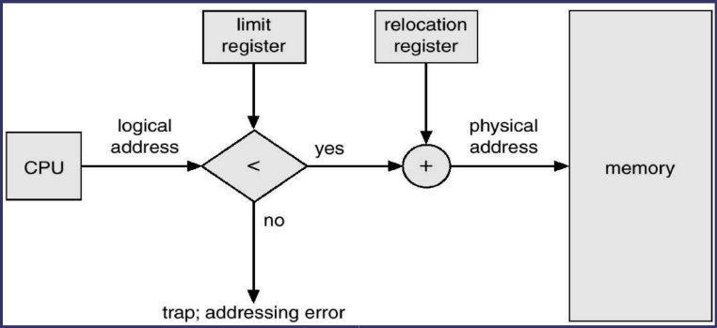
Addresses
Logical Address: These addresses are generated by CPU and also known as virtual address
Physical Address: These address are actual addresses loaded into memory address register
Mapping uses two register: Base and Limit registers

Slide 13
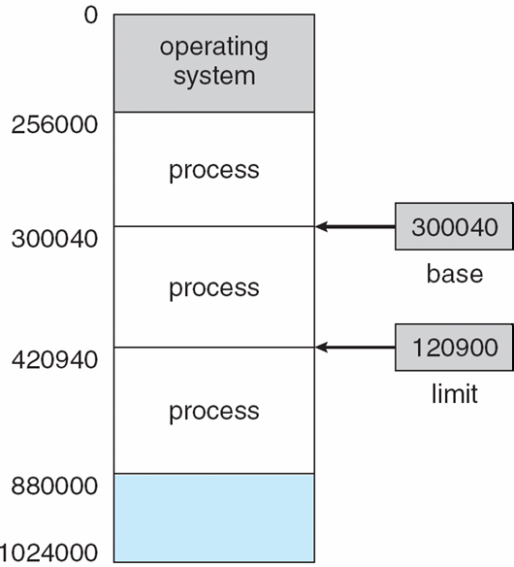
Base and Limit Registers
420940

Slide 14
Modelling Multiprogramming
In monoprogramming, CPU utilization is (1-p)
where, p is often > 0.5 which shows the utilization of CPU is poor
In multiprogramming, CPU utilization is (1-p^{n})
where, n is the number of processes in memory waiting for I/O

Slide 15
Fragmentation
Divided into multiple small parts
the process is loaded and unloaded from memory, there exists free space which are fragmented that cannot be allocated to incoming processes
It is an unwanted problem is OS
Two types of fragmentation:
Internal Fragmentation - if the process is smaller than the amount of memory requested, a free space is created in the given memory block. Due to this, the free space of the memory block is unused, which causes internal fragmentation
External Fragmentation - when a dynamic memory allocation method allocates some memory but leaves a small amount of memory unusable

Slide 16
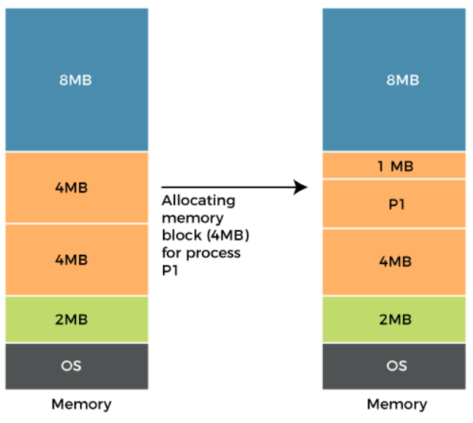
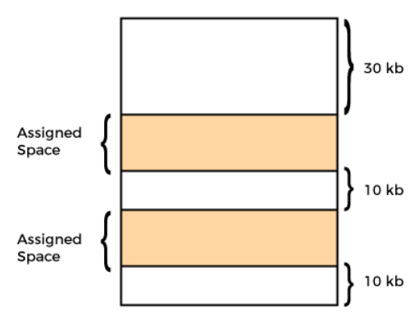
Types of Fragmentation
Internal
External

Slide 17
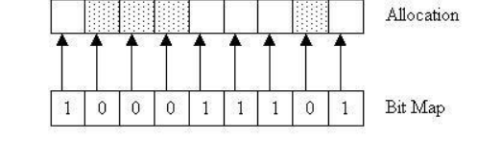
Bitmap or bit-vector
Series or collection of bits where each bit corresponds to a disk block
The bit takes two values 0 and 1
where, 0 is allocated block and 1 is free block

Slide 18
Linked List
The free disk blocks are linked together i.e. a free block contains a pointer to the next free block
The block number of the very first disk block is stored at a separate location on disk and is also cached in memory

Slide 19
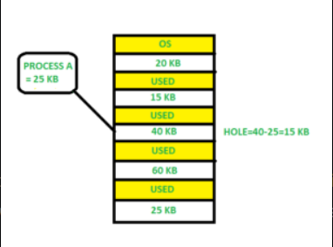
Memory Allocation Strategies
First Fit
The partition is allocated which is the first sufficient block from the top of memory
It scans memory from the beginning and chooses the first available block that is large enough
Thus it allocates the first hole that is large enough

Slide 20
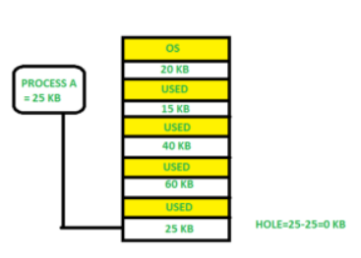
MAS (contd.)
Best Fit
Allocate the process to the partition which is the first smallest sufficient partition among the free available partition
It searches the entire list of holes to find the smallest hole whose size is greater than or equal to the size of the process

Slide 21
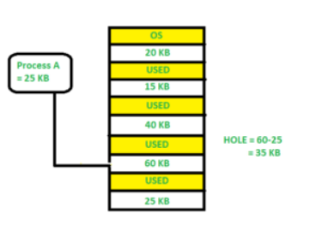
MAS (contd.)
Worst Fit
Allocate the process to the partition which is the largest sufficient among the freely available partitions available in the memory
It is opposite to the best-fit algorithm. It searches the entire list of holes to find the largest hole and allocate it to process

Slide 22
MAS - Numerical
Given memory partitions of 100 KB, 500 KB, 200 KB, 300 KB, 600 KB in order. How would it fit under best, worst and first algorithms when processes of 212 KB, 417 KB, 112 KB and 426 KB in order needs to be executed. Which algorithm makes the most efficient use of the memory?

Slide 23
MAS - Numerical
Given memory partitions of 100 KB, 500 KB, 200 KB, 300 KB, 600 KB in order. How would it fit under best, worst and first algorithms when processes of 212 KB, 417 KB, 112 KB and 426 KB in order needs to be executed. Which algorithm makes the most efficient use of the memory?
First
212- 500
417- 600
112- 288 (500-212)
426 must wait
Best
212 - 300
417 – 500
112 – 200
426 - 600
Worst
212 – 600
417 – 500
112 – 388
426 must wait

Slide 24
MAS - Numerical
Given memory partitions of 100KB, 200KB, 300KB, 400KB, 500KB in order. How would it fit under best, worst and first algorithms when processes of 202KB, 404KB and 90KB in order needs to be executed. Which algorithm makes the most efficient use of the memory?

Slide 25
Compaction
Technique to collect and combine the free spaces and relocate it so that the space is big enough to be allocated by some programs
The merging of those free partitions and allocating according to the needs of process - defragmentation

Slide 26
Virtual Memory
Combined size of the program, data, and stack may exceed the amount of physical memory available for it
The operating system keeps those parts of the program currently in use in main memory, and the rest on the disk
Only part of the program needs to be in memory for execution
Logical address space can therefore be much larger than physical address space
Allows address spaces to be shared by several processes
Allows for more efficient process creation
More programs running concurrently
Less I/O needed to load or swap processes

Slide 27
Virtual Memory (contd.)
For example, a 16-MB program can run on a 4-MB machine by carefully choosing which 4 MB to keep in memory at each instant, with pieces of the program being swapped between disk and memory as needed
Virtual memory can be implemented by two most commonly used methods :
Paging
Segmentation
or mix of both

Slide 28
Virtual Address Space
Logical view of how process is stored in memory
Usually start at address 0, contiguous addresses until end of space
Meanwhile, physical memory organized in page frames
MMU must map logical to physical

Slide 29
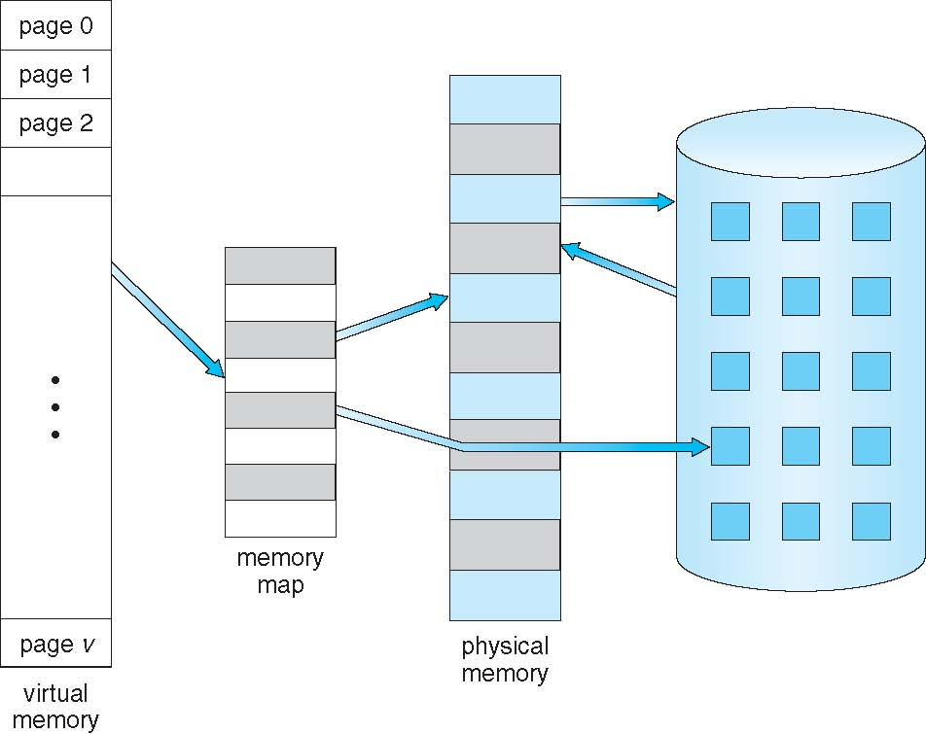
Virtual Memory That is Larger Than Physical Memory

Slide 30

Paging
The virtual address space is divided up into units - pages
The corresponding units in the physical memory - page frames
The pages and page frames are always the same size
Transfers between RAM and disk are always in units of a page

Slide 31
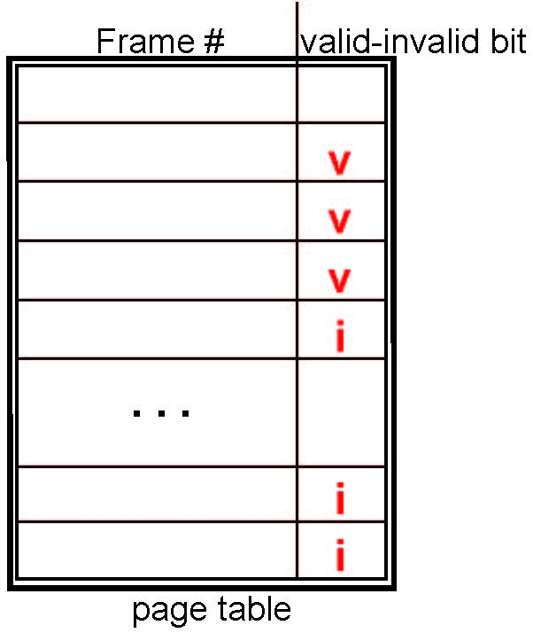
Valid-Invalid Bit
With each page table entry a valid–invalid bit is associated (v ⇒ in-memory – memory resident, i ⇒ not-in-memory)
Initially valid–invalid bit is set to i on all entries

Slide 32
Address Translation Scheme
Address generated by CPU is divided into
Page Number (p)
Used as an index into a page table which contains base address of each page in memory
Page Offset (d)
The part of a virtual address that specifies the location of a byte within a page
Page Number(p) Page offset (d)
m-n bit n bit
Logical address is 2^{m} and page size 2^{n}

Slide 33
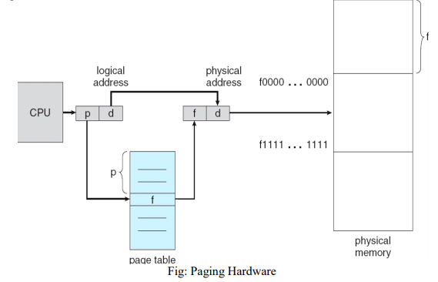
Paging (contd.)

Slide 34
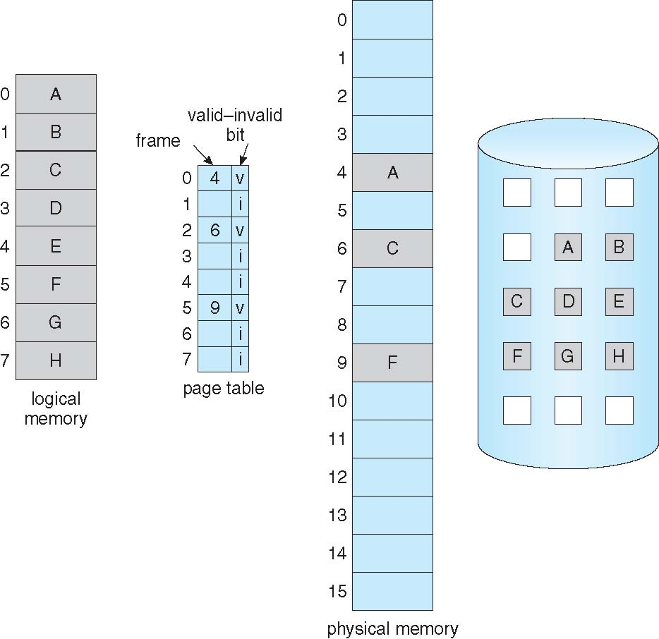
Page Table

Slide 35
Implementation of page table
Page table base register (PTBR) points to page table
Page table length register (PTLR) indicates the size of page table
Here, Every data/instruction access requires two memory accesses
One for page table another for data/instructions
The two memory access problem can be solved by using a special fast lookup hardware cache called Translation look aside buffers (TLB)
TLB is typically small to entries

Slide 36
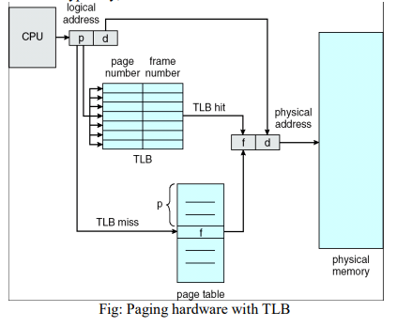
Paging with TLB

Slide 37
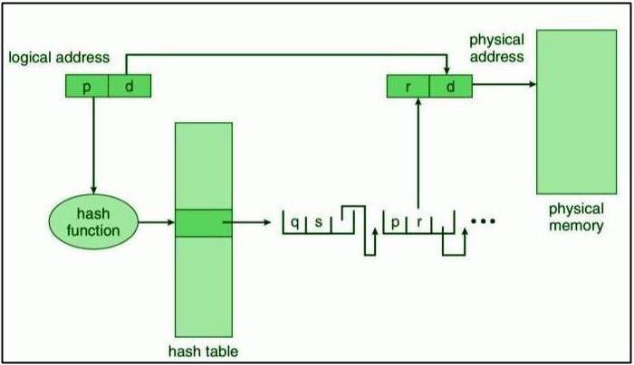
Hash Page Table

Slide 38
Segmentation
The memory is divided into the variable size parts.
Each parts is known as segments
These segments are allocated to a process
Details about the segments are stored in a table called segment table
Segment table mainly contains:
Base Address
Limit

Slide 39
Why Segmentation?
A process is divided into Segments
The chunks that a program is divided into which are not necessarily all of the same sizes are called segments
Segmentation gives the user’s view of the process which paging does not give because paging is more close to the OS more than user
It may divide the same computation function into multiple parts and those pages may or may not be loaded at same time into the memory

Slide 40
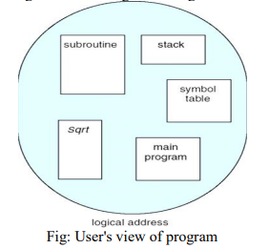
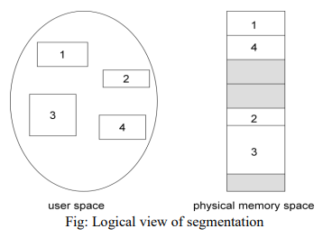
Segmentation (contd.)

Slide 41
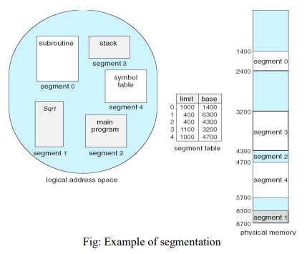
Segmentation (contd.)

Slide 42
Adv. / Dis Adv. Of Segmentation
Advantages
No internal fragmentation
Less overhead
Easier to reallocate segments than entire address space
Segmentation table is lesser in size than page table
Disadvantages
May have external fragmentation
Difficult to allocate contiguous memory to variable sized partition

Slide 43
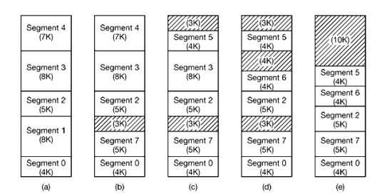
Implementation of Segmentation

Slide 44
Page Replacement Algorithms
Algorithms decides which page is replace by which page
When a page fault occurs, the OS has to choose a page to remove from memory to make the room for the page that has to be brought in
Pages should exist in order to not have page fault

Slide 45
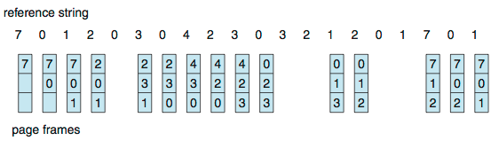
FIFO
Reference string: 7,0,1,2,0,3,0,4,2,3,0,3,0,3,2,1,2,0,1,7,0,1
3 frames (3 pages can be in memory at a time per process) 15 page faults

Slide 46
Belady’s Anomaly

Slide 47
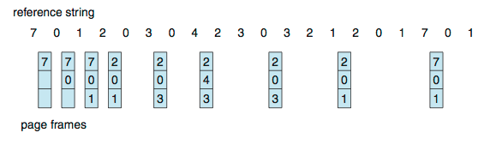
OPR (Optimal Page Replacement)
Replace page that will not be used for longest period of time

Slide 48
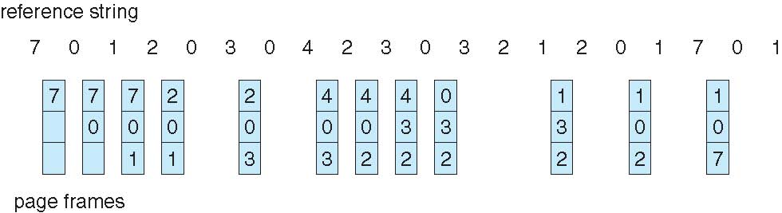
Least Recently Used (LRU)
Replace page that has not been used in the most amount of time

Slide 49
Least Frequently Used (LFU)
Reference string: 7,0,1,2,0,3,0,4,2,3,0,3,0,3,2,1,2,0,1,7,0,1
3 frames (3 pages can be in memory at a time per process)

Slide 50
Clock Page Replacement (CPR)
Reference string: 7,0,1,2,0,3,0,4,2,3,0,3,0,3,2,1,2,0,1,7,0,1
3 frames (3 pages can be in memory at a time per process)

Slide 51
Second Chance Page Replacement (SCPR)
Reference string: 7,0,1,2,0,3,0,4,2,3,0,3,0,3,2,1,2,0,1,7,0,1
3 frames (3 pages can be in memory at a time per process)

Slide 52
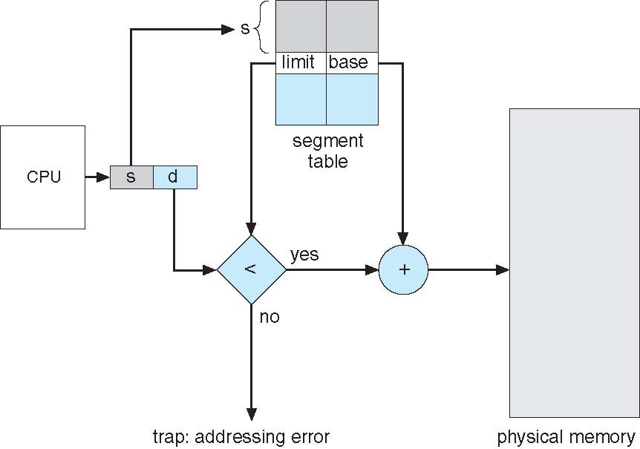
Segmentation with Paging: MULTICS

Slide 53
Banker Algorithm (Practice)
Process Allocation Available Max A B C D A B C D A B C D
Po 0 0 1 2 0 0 1 2 1 5 2 0
P1 1 0 0 0 1 7 5 0
P2 1 3 5 4 2 3 5 6
P3 0 6 3 2 0 6 5 2
P4 0 0 1 4 0 6 5 6

